Slide 1

KLS Gogte Institute Of Technology, Belagavi
Seminar on Project Synopsis (Design Thinking Approach)
Project Phase 1
Presented by:
Pavan Chikkodikar 2GI19CS089
Laxmikant Pujeri 2GI19CS063
Narasimha Katti 2GI19CS079
Niranjan Baloji 2GI19CS083
Guided By : Prof. Sagar Pujar

Slide 2
Problem Statement
Crop Suitability and Weather Forecast Recommendation System Using Machine Learning Approach

Slide 3
Abstract
Agriculture and its allied sectors are undoubtedly the largest providers of livelihoods in rural India. The agriculture sector is also a significant contributor factor to the country’s GDP.
However, regrettable is the yield per hectare of crops in comparison to international standards. This is one of the possible causes for a higher suicide rate among marginal farmers in India.
This paper proposes a viable and user-friendly yield prediction system for the farmers. The proposed system provides connectivity to farmers via a web application.
The user provides the area & soil type as input. Machine learning algorithms allow choosing the most profitable crop list or predicting the crop yield for a user-selected crop.

Slide 4
To predict the crop yield, selected Machine Learning algorithms such as Support Vector Machine (SVM), Artificial Neural Network (ANN), Random Forest (RF), Multivariate Linear Regression (MLR), and K-Nearest Neighbour (KNN) are used.
Among them, the Random Forest showed the best results with 95% accuracy. Additionally, the system also suggests the best time to use the fertilizers to boost up the yield.

Slide 5
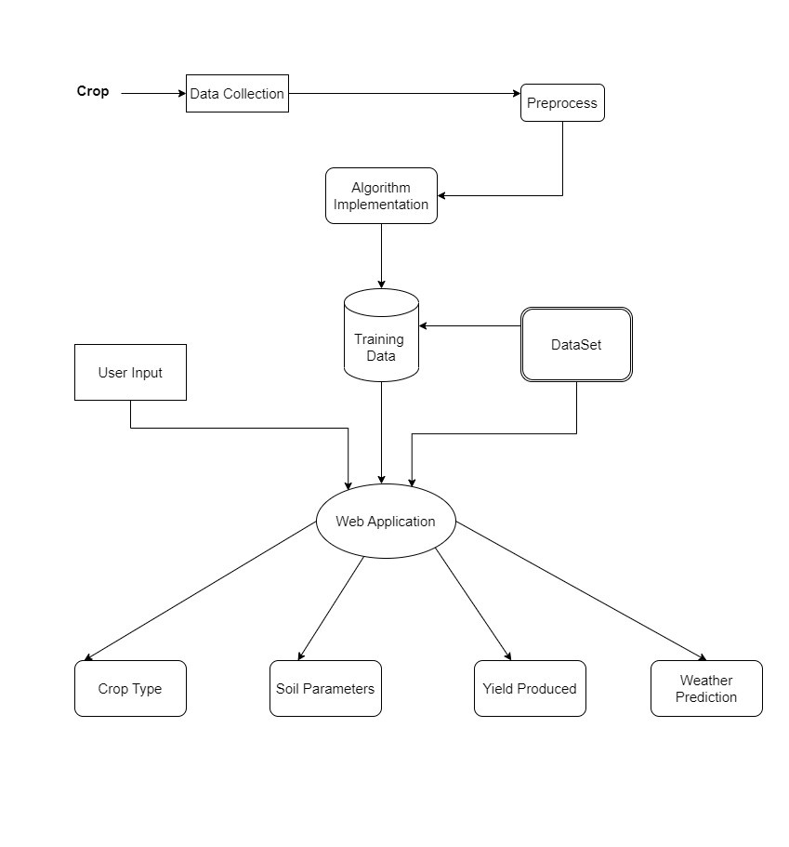
Flow Diagram:

Slide 6
Existing System
Extensive work has been done, and many ML algorithms have been applied in the agriculture sector. The biggest challenge in agriculture is to increase farm production and offer it to the end-user with the best possible price and quality. It is also observed that at least 50% of the farm produce gets wasted, and it never reaches the end-user.
One of the recent works, presented a model where the crop yield is predicted using KNN algorithms by making the clusters and also using advanced regression techniques like Lasso and Ridge algorithms. It has been shown that KNN clustering proved much better than SVM or regression. Where it helps to enhance the accuracy of the algorithms.

Slide 7
Disadvantages of Existing System:
The main challenge faced in agriculture sector is the lack of knowledge about the changing variations in climate. Each crop has its own suitable climatic features. This can be handled with the help of precise farming techniques.
The existing system which recommends crop yield is either hardware-based being costly to maintain, or not easily accessible.
Despite many solutions that have been recently proposed, there are still open challenges in creating a user-friendly application with respect to crop recommendation.

Slide 8
Proposed System:
In this project, we have proposed a model that addresses the existing issues. The novelty of the proposed system is to guide the farmers to maximize the crop yield as well as suggest the most profitable crop for the specific region.
The proposed model provides crop selection based on economic and environmental conditions, and benefit to maximize the crop yield that will subsequently help to meet the increasing demand for the country’s food supplies. The proposed model predicts the crop yield by studying factors such as rainfall, temperature, area, season, soil type etc. The system also helps to determine the best time to use fertilizers.
The user provides an area under cultivation and soil type as inputs. According to the requirement, the model predicts the crop yield for a specific crop. The model also recommends the most profitable crop and suggests the right time to use the fertilizers.
The main objective is to obtain a better variety of crops that can be grown over the season. The proposed system would help to minimize the difficulties faced by farmers in choosing a crop and maximize the yield.

Slide 9
Advantages of Proposed System:
The proposed model predicts the crop yield for the data sets of the given region. Integrating agriculture and ML will contribute to more enhancements in the agriculture sector by increasing the yields and optimizing the resources involved. The data from previous years are the key elements in forecasting current performance.
The proposed system uses recommender system to suggest the right time for growing crops.
The methods in the proposed system includes increasing the yield of crops, real-time analysis of crops, selecting efficient parameters, making smarter decisions and getting better yield.

Slide 10
SYSTEM REQUIREMENTS:
HARDWARE REQUIREMENTS:
SOFTWARE REQUIREMENTS:
System : Pentium i3 Processor.
Hard Disk : 150 GB.
Monitor : 12’’ LED
Input Devices : Keyboard, Mouse
Ram : 4 GB
Operating system : Windows 7 .
Coding Language : Python
Web Framework : Flask
Domain : Machine Learning

Slide 11
Conclusion:
As our farmers presently are not using technology in their farming practices, they are lagging behind in their farming approaches. Hence, we have made this project so as to encourage farmers to use the current technology instead of relying on old methods. Growing a crop requires a lot of knowledge and insight into many things such as the contents of soil, temperature, pH of soil etc. and hence it would make sense for the farmer to adopt to newer technologies as it would make his life easier. Using machine learning algorithms, we predicted an accuracy of 98% of predicting the right crop to grow and if the farmer adopts to this technology which would not only make his life easier but also help him in making decisions that do not exploit the environment.

Slide 12
References:
SHILPA MANGESH PANDE, DR. PREM KUMAR RAMESH, ANMOL, B.R AISHWARYA, KARUNA ROHILLA, KUMAR SHAURYA, “Crop Recommender System Using Machine Learning Approach”, IEEE Conference 2021.
Archana Chougule, Vijay Kumar Jha and Debajyoti Mukhopadhyay “Crop Suitability and Fertilizers Recommendation using Data Mining Techniques” Springer Nature Singapore Pte Ltd. 2019

Slide 13
Thank You

